Slide 1
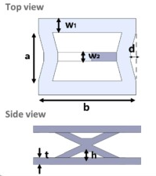




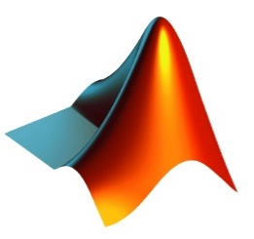
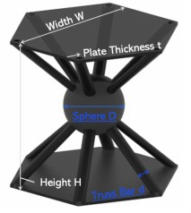
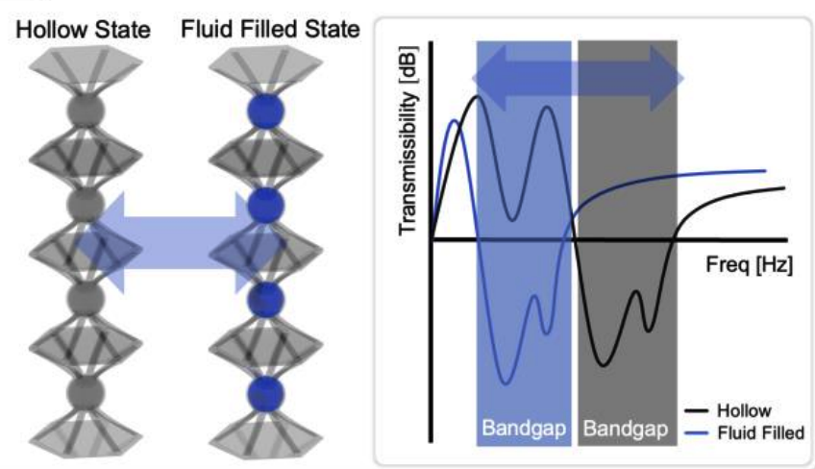
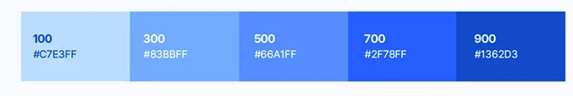
Design variables
(w₁, w₂, d, a, b, t, h)
Vibration characteristics
[dB]
Vibration Reduction Mount Optimal Design Framework
Design variables
(w₁, w₂, d, a, b, t, h)
Vibration Reduction Mount Optimal Design Framework

